Slide 1

HISTORICAL POPULARITY INDEX

Slide 2
About me
Background ? (B-tech or M-tech): My name is Meghana Chevvuri. I have completed my B.Tech in Electronics and Communication Engineering (ECE).
Why you want to learn Data Science : I want learn Data Science because it enables me to turn data into insights that provides better decisions and it aligns well with my interest in analysis, problem solving and real world applications.
Any work experience: I am fresher.

Slide 3
Dataset Overview
The dataset contains 11,341 rows and 17 columns representing information about people and popularity of their articles.
It includes 10 categorical and 7 numerical columns.
Columns include: article_id, full_name, sex, birth_year, city, state, country,continent, latitude, longitude, occupation, industry, domain, article_languages,
page_views, average_views, historical_popularity_index

Slide 4
Simple description of each column in your dataset:
article_id – Unique ID for each article/person
full_name – Name of the person
sex – Gender of the person
birth_year – Year the person was born
city – City the person belongs
state – State the person lives
country – Country the person is from
continent – Continent the person from
latitude – Latitude of the location
longitude – Longitude of the location
occupation – Person’s job or profession
industry – Industry the person works
domain – Field or area of expertise
article_languages – Number of languages the article is available
page_views – Total number of times the article was viewed
average_views – Average number of views
historical_popularity_index – Overall long-term popularity score

Slide 5
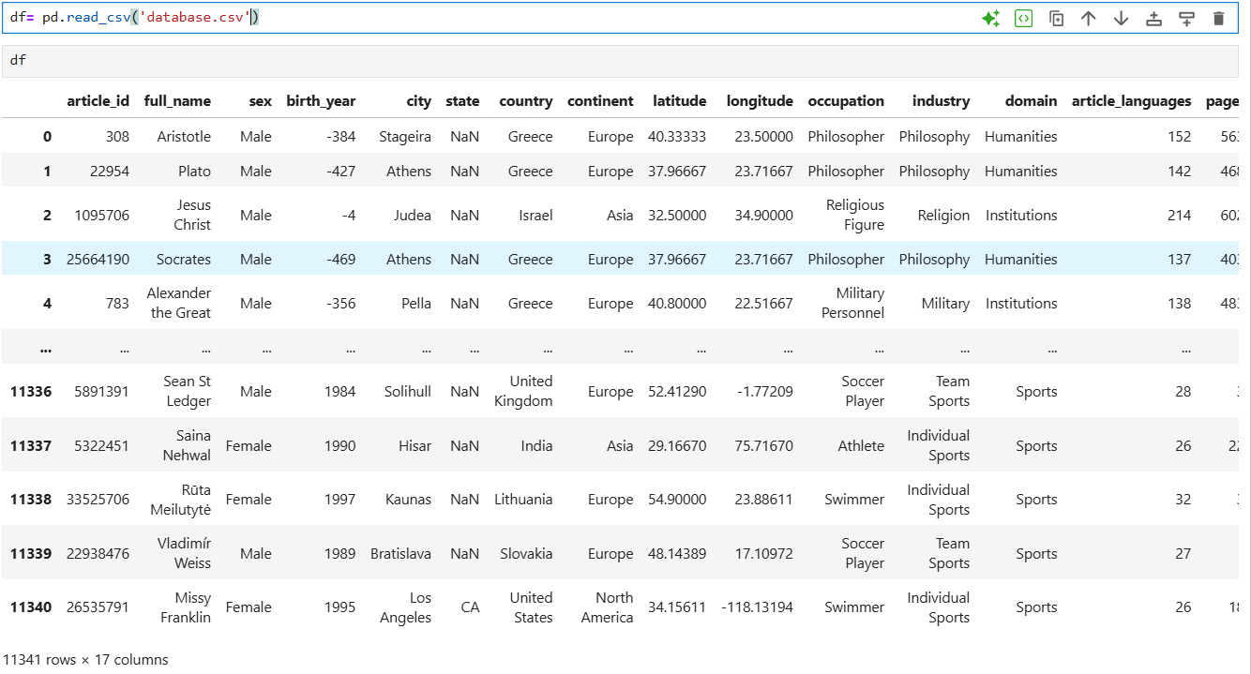
Reading Dataset

Slide 6
Phase 1 : Data Understanding

Slide 7
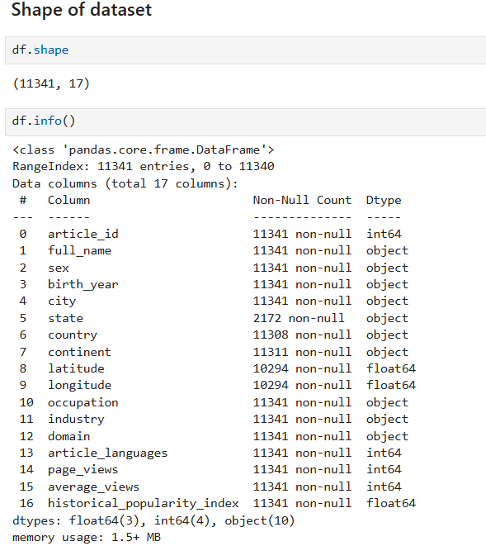
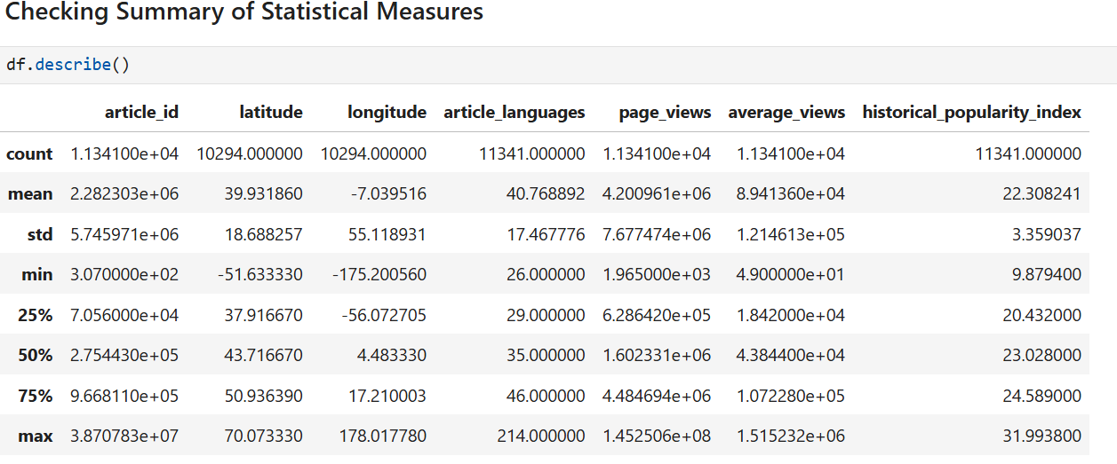
Basic Checks

Slide 8
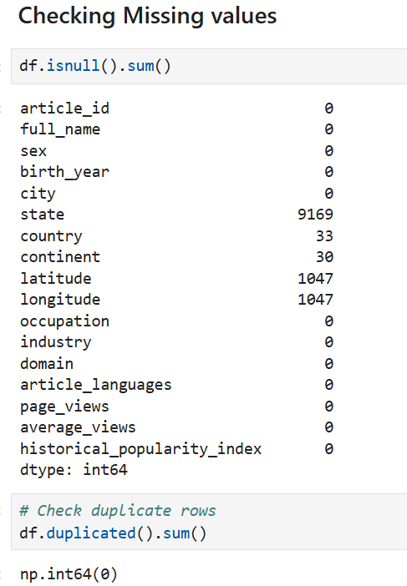
Identify columns that require cleaning or preprocessing
5 Columns have Missing Values
No duplicates
Now ,Perform some Preprocessing Techniques on columns like:
Handling Missing Values
Handling Inconsistence Data
Data Type Conversions

Slide 9
Phase 2 : Data Cleaning & Manipulation

Slide 10
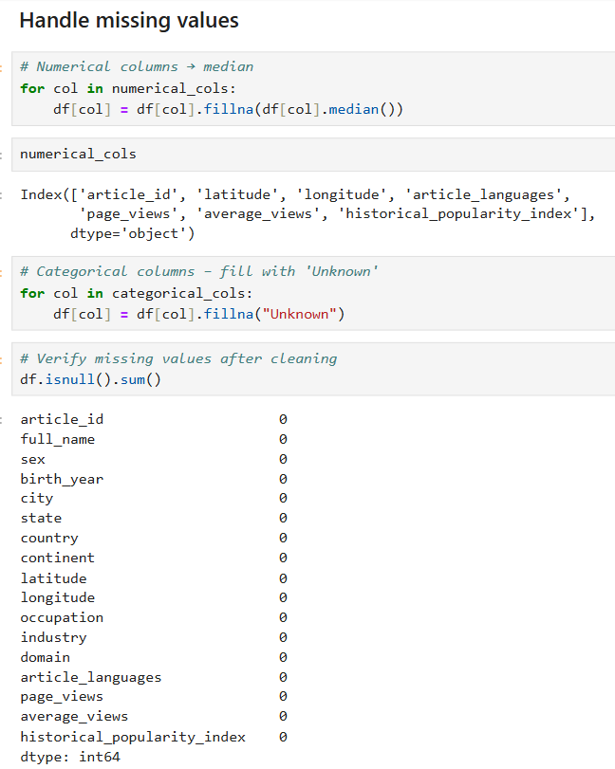
Handling Missing Values
Numerical Column:
1. Missing values filled using median
2. Suitable for skewed data and outliers
Categorical Column:
1.Missing values filled with “Unknown”.
2. Preserves rows without making assumptions
jkr
jk

Slide 11
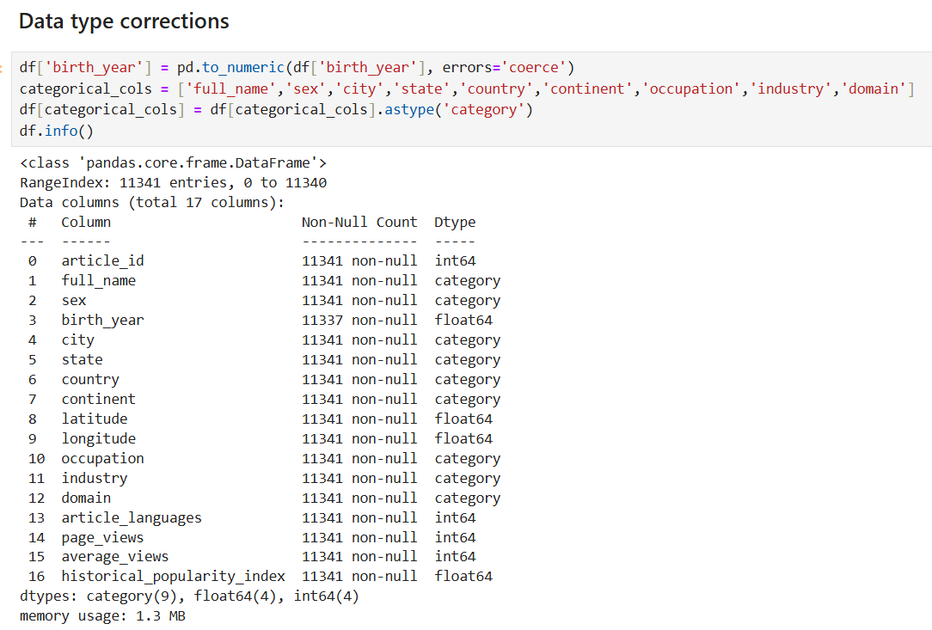
Data Type Corrections
Data Type Corrections:
Converted birth year from text (object) to numeric (float64) using pd.to_numeric to enable age-related calculations and numerical analysis.
Used errors='coerce' to safely handle any invalid or non-numeric values without breaking the dataset.
Converted repeated text-based columns (full_name, sex, city, state, country, continent, occupation, industry, domain) to the ccategory data type.
Retained numerical columns (article_id, article_languages, page_views, average_views) as integers to preserve their quantitative meaning.
Geographic coordinates (latitude, longitude) and popularity score (historical_popularity_index) were correctly kept as floating-point values.

Slide 12
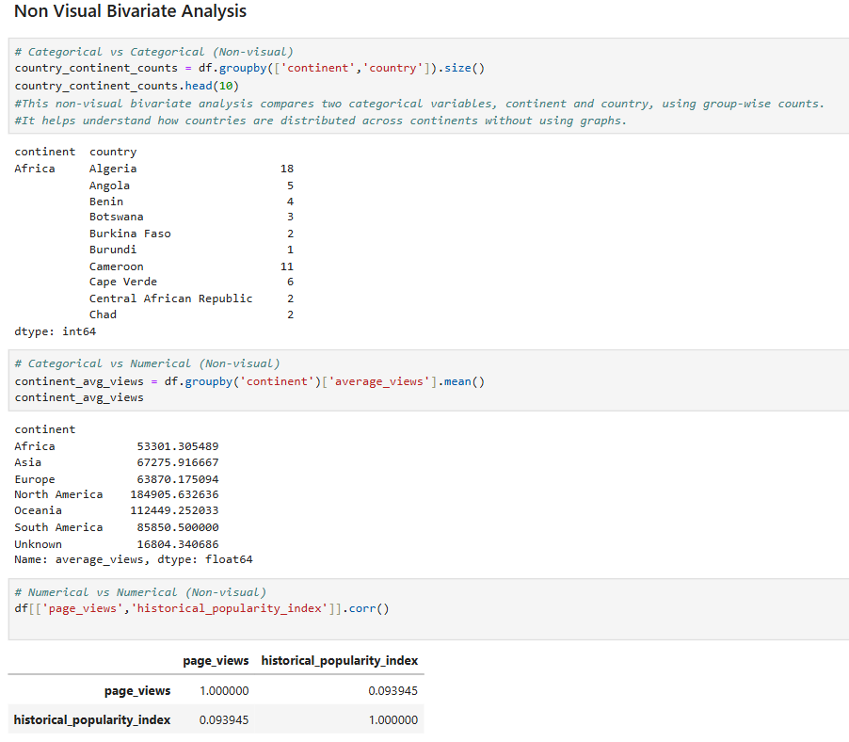
Non Visual Bivariate Insights
Continent vs Country (Categorical–Categorical ):
Countries are grouped under their respective continents.
African countries show varying representation rather than uniform counts.
Certain countries dominate the data in their continent.
Continent vs Average Views (Categorical–Numerical):
North America has the highest average views.
Oceania and South America also show relatively high average views.
Africa and Asia have comparatively lower average views.
Higher representation or popularity in certain regions may influence results.
Page Views vs Historical Popularity Index (Numerical–Numerical):
The correlation value between page views and historical popularity index is very low.
The relationship is positive but weak.
Higher historical popularity does not strongly correspond to higher page views.
Other factors may influence page views more significantly.

Slide 13
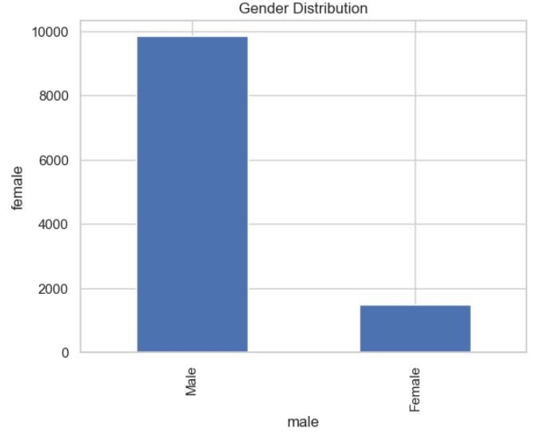
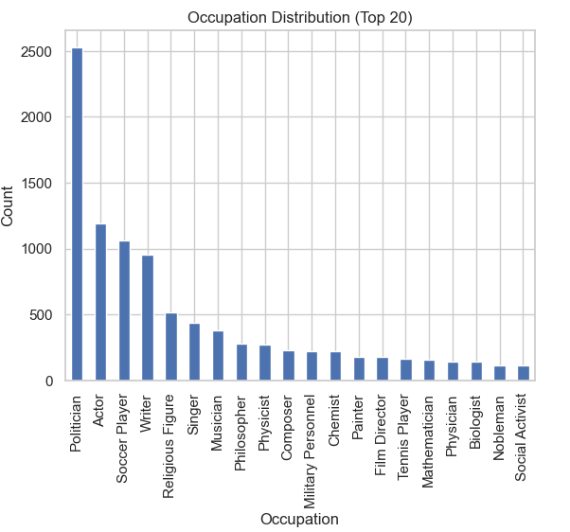
Data Analysis Through Visualizations
Univariate Analysis
Gender Distribution:
The dataset is heavily dominated by male individuals.Female representation is very low compared to males.
The dataset shows a clear gender imbalance.
Occupation Distribution:
A few occupations appear very frequently, while most others occur less often.
Professions related to philosophy, politics, religion, and writing dominate the dataset. Many occupations have relatively small counts.
The dataset is skewed toward certain professions.There is an uneven representation of occupations.

Slide 14
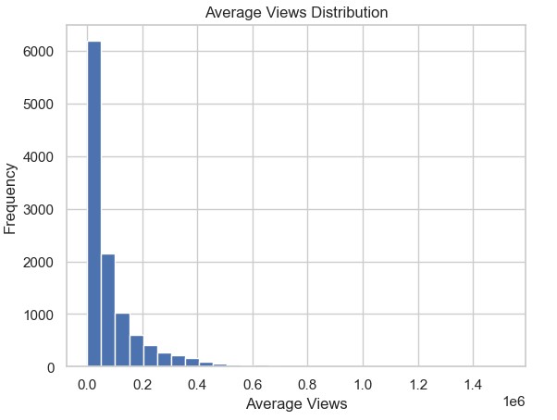
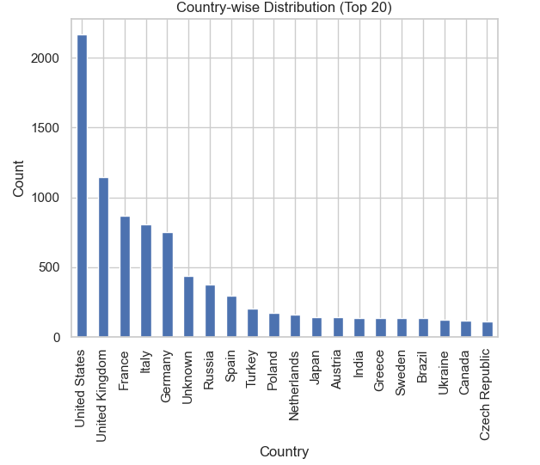
Average Views Distribution:
Most data points are concentrated at low average view values.
A small number of entries have very high views. Few high-view entries act as outliers and increase overall spread.
The distribution is right-skewed.
Country- wise Distribution:
The United States has the highest number of entries.
Countries like the United Kingdom, France, Italy, and Germany also show high representation.
Many countries have relatively low and similar counts.
Representation across countries is uneven.

Slide 15
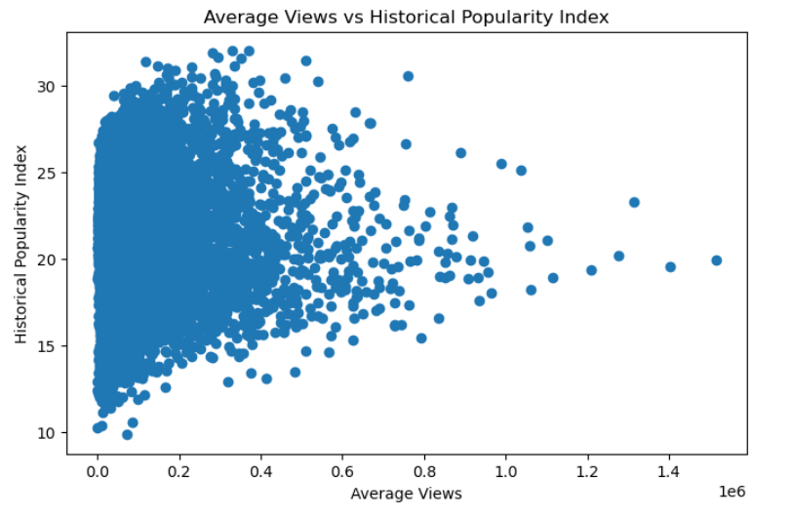
Bivariate Analysis
Numerical - Numerical
Average Views vs Historical Popularity Index:
Points are widely scattered with no clear upward or downward trend.
Most data points are clustered at low average views.
A few entries show very high average views but varying popularity index values.
The relationship between average views and historical popularity is weak.
High popularity does not necessarily result in high average views.

Slide 16
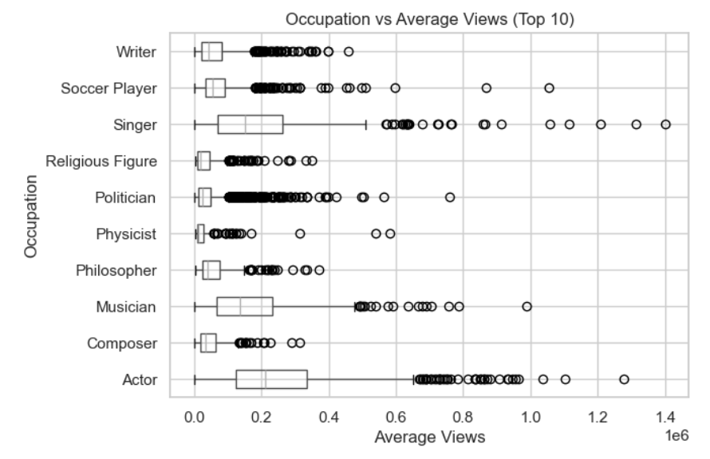
Categorical - Numerical
Occupation vs Average Views (Top 10):
Average views vary significantly across different occupations.
Actors, singers, and musicians show higher median average views compared to other occupations.
Occupations like philosophers, physicists, and religious figures generally have lower median views.
Many occupations show a large number of outliers, indicating extreme values.
Entertainment-related occupations tend to attract higher public attention.
Academic or philosophical professions have more consistent but lower viewership.
Wide spread in some occupations suggests unequal popularity within the same profession.

Slide 17
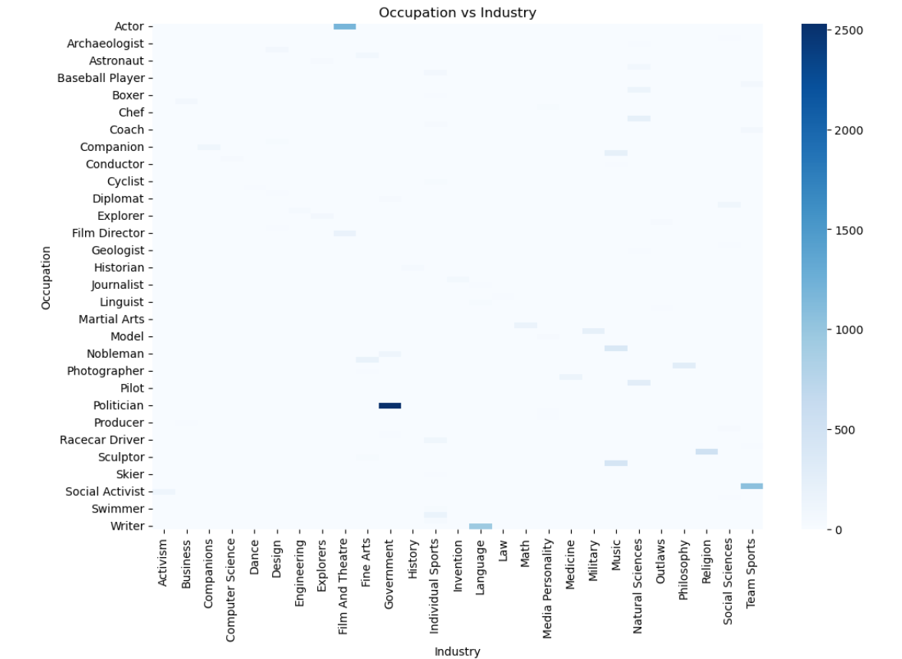
Categorical - Categorical
Occupation Vs Industry:
Certain occupations are strongly concentrated in specific industries.
Political roles show very high association with the Government industry.
Writers and philosophers are mainly associated with Literature and Philosophy-related industries.
Many occupation–industry combinations show very low or no occurrence.
Occupations are not randomly distributed across industries.
Clear domain specialization is visible in the data.

Slide 18
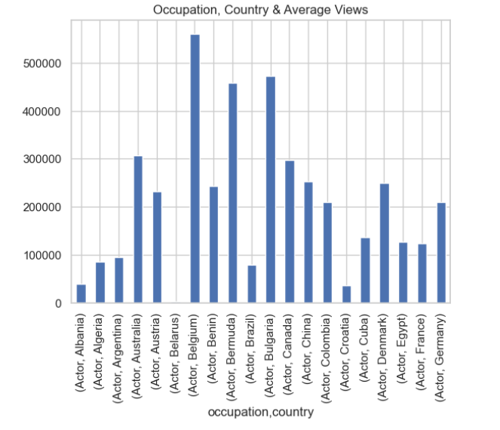
Multi-variate Analysis
Occupation, Country by Average Views:
Average views for the same occupation vary significantly across countries.
Actors from certain countries show much higher average views than others.
Some occupation–country combinations have relatively low average views.
Popularity of an occupation is location-dependent.
Country plays an important role in determining visibility and reach.

Slide 19
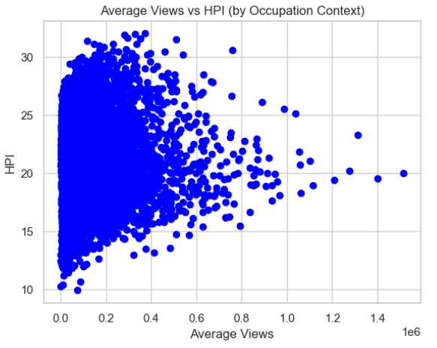
Average Views vs Historical Popularity index by Occupation :
Data points are densely clustered at low average views across all popularity levels.
A few individuals have very high average views, but their historical popularity varies.
No clear linear pattern is visible between average views and historical popularity.
High historical popularity does not consistently translate to high average views.
Viewership appears to be influenced by factors beyond historical significance, such as modern relevance or media exposure.

Slide 20
Conclusion
The dataset was cleaned and prepared for analysis by handling missing values, removing duplicate records.
Data imbalance and skewed distributions were observed.
Views and popularity depend on multiple factors like occupation and location.
The dataset is clean, consistent, and analysis-ready for exploratory data analysis and further modeling.

Slide 21

Thank You

